Slide 1
Session 6
GDI+ Programming

Slide 2
Review
ADO.NET is basically made up of two components such as DataSet and .NET data providers.
DataSets are objects that store data in a disconnected cache.
The .NET data providers is a collection of components such as:
  Connection
  Command
  DataReader
  DataAdapter
The Connection object is used to establish a connection between the application and the database.
The Command object allows retrieval and manipulation of data in the database.
DataReader is used to get the read-only and forward-only data from the data source.
DataAdapter is used to fetch the values from the data source to the DataSet and also to update the data source with the values in the DataSet.

Slide 3
Review Contd…
The data in the DataSet is stored in the form of DataTable objects.
The DataColumn object defines the columns of a DataTable. The DataColumn object is referenced by the Columns property of the DataTable.
The DataRow object represents the rows of data in a DataTable.
DataView acts as a presentation layer for the data that is stored in DataTable. It provides a customized view of DataTable for sorting, filtering and searching data.
If the tables that are included in the DataSet have a logical relationship between them, the related records can be made available in another table using the DataRelation object.
ADO.NET supports two type of Data Binding:
  Simple Data Binding - only a single value from a dataset can be bound to any control at a given time
  Complex Data Binding - a control can be bound to a complete dataset
The DataGrid control displays data in a tabular format and optionally supports data editing; i.e. inserting, updating, deleting, sorting and paging.

Slide 4
Objectives
Create Graphical Images with GDI+
Explore Objects in GDI+: Pen, Brush and Color
Draw lines, shapes and text with GDI+
Display images using GDI+
Print Images using GDI+

Slide 5

Introduction to GDI+
What is GDI+?
GDI+ provides the basic functionality to implement graphics in WinForms. GDI+ resides in System.Drawing.dll assembly.
Using classes such as System.Drawing.Text, System.Drawing.Drawing2D and System.Drawing.Printing, shapes can be drawn and filled, colorful attractive text can be rendered and images can be drawn without using any picture controls.

Slide 6
Graphics class
Graphics
Present in the System.Drawing namespace.
Cannot be inherited.
A Graphics object can be created in several ways:
  By overriding the OnPaint() method and getting the reference to the graphics
  Using the Paint event of a form to get the reference to the graphics
  Using the CreateGraphics() Method
  From any object that derives from Image class

Slide 7
Creating a Graphics reference
protected override void OnPaint(PaintEventArgs paintevent)
{
Graphics graf=paintevent.Graphics;
}
private void mainForm_Paint(object sender, PaintEventArgs paintevent)
{
Graphics graf=paintevent.Graphics;
}

Slide 8
Creating a Graphics reference Contd…
private void PaintMe(Control testcontrol)
{
Graphics graf=testcontrol.CreateGraphics();
. . .
}
protected override void OnPaint(PaintEventArgs paintevent)
{
Bitmap bmpimage=new Bitmap("Water Lilies.jpg");
Graphics graf = Graphics.FromImage (bmpimage);
...
}

Slide 9
Methods of Graphics class
Method Name Description
Clear Clears the drawing surface and fills it
with specified background color
DrawArc Draws an arc
DrawBezier Draws a Bezier curve
DrawEllipse Draws an ellipse
DrawImage Draws an image
DrawLine Draws a line
DrawString Draws a text string
DrawRectangle Draws a rectangle
FillEllipse Fills an ellipse with color
FillRectangle Fills a rectangle with color

Slide 10

The Pen class
Pen
Used to specify the width, styles, fill styles for shapes.
Cannot be inherited but we can create objects by instantiating it.
Belongs to the System.Drawing namespace.
Pen ourpen=new Pen(Color.Blue,5);
The above code will create a pen object of blue color with width 5

Slide 11


The Brush class
Used to fill solid color into shapes.
Abstract class hence cannot be instantiated
Belongs to the System.Drawing namespace.
Brushes can be created using the SolidBrush, LinearGradientBrush, and TextureBrush classes.
SolidBrush myBrush = new SolidBrush(Color.Blue);
The above code creates a brush that fills in solid blue.

Slide 12
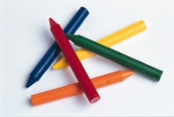
Color structure
Used to create or use colors
for graphics in GDI+.
Graphics graph=e.Graphics;
graph.Clear(Color.MistyRose);
The above code will fill up the screen with MistyRose color

Slide 13

DrawLine() method
The DrawLine() method of the Graphics
class is used to draw a line on the screen.
Overloaded List:
public void DrawLine(Pen, Point, Point);
public void DrawLine(Pen, PointF, PointF);
public void DrawLine(Pen, int, int, int, int);
public void DrawLine(Pen, float, float, float, float);

Slide 14
DrawString() method
Displays text on the screen without using any text
related controls.
Overloaded List:
a,b,c
public void DrawString(string, Font, Brush, PointF);
public void DrawString(string, Font, Brush, RectangleF);
public void DrawString(string, Font, Brush, PointF, StringFormat);
public void DrawString(string, Font, Brush, RectangleF, StringFormat);
public void DrawString(string, Font, Brush, float, float);
public void DrawString(string, Font, Brush, float, float, StringFormat);

Slide 15
DrawImage() method
Used to draw images using an Image object. Typically, GIF, JPG, BMP images are drawn.
Constructors:
public void DrawImage(Image, Point)
public void DrawImage(Image, Point[])
public void DrawImage(Image, PointF)
public void DrawImage(Image, PointF[])
public void DrawImage(Image, Rectangle)

Slide 16
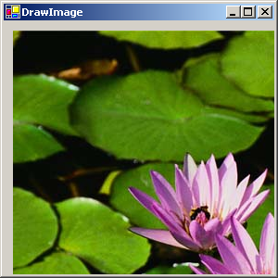
Drawing a JPG image
protected override void OnPaint(PaintEventArgs p_event)
{
  int x_coord,y_coord;
  Image testimage=Image.FromFile("Water lilies.jpg");
  Graphics graf=p_event.Graphics;
  x_coord=10; y_coord=10;
  graf.DrawImage(testimage,x_coord,y_coord);
}
Output

Slide 17
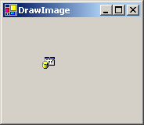
Drawing a Icon
protected override void OnPaint(PaintEventArgs paintevt)
{
Image img=Image.FromFile("Provider.ico");
Graphics graf=Graphics.FromImage (img);
paintevt.Graphics.DrawImage(img,50,50);
}
Output

Slide 18
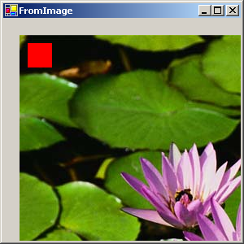
Displaying a Modified Image
Output
protected override void OnPaint(PaintEventArgs paintevent)
{
Bitmap bmpimage=new Bitmap("Water Lilies.jpg");
Graphics graf = Graphics.FromImage (bmpimage);
graf.FillRectangle(new SolidBrush(Color.Red),10,10,30,30);
Graphics modGraf = paintevent.Graphics ;
modGraf.DrawImage(bmpimage, 20, 20);
}

Slide 19
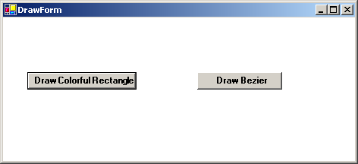
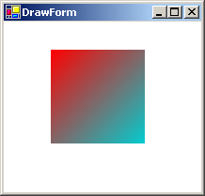
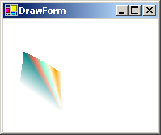
Graphics Application 1

Slide 20
Graphics Application Contd…
Create a blank form in a Windows application
Add two button controls to it.
Rename these button controls as btnRect and btnBezier respectively.
Write code for the Click event of these buttons and set a flag which will be used in the Paint() method to determine whether to paint a rectangle or a Bezier curve.
Override the OnPaint() method and write the appropriate code to draw a rectangle or draw a Bezier curve depending upon the option chosen.

Slide 21
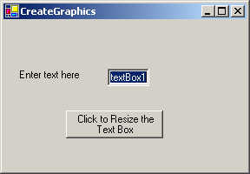
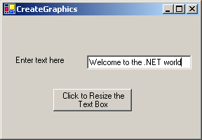
Graphics Application 2
Create a blank form in a Windows application
Create the interface of the form as shown in Figure
Rename the button control as btnResize
Create a user defined method ChangeControlSize to resize the control based on the contents of the control. This method would accept two parameters: the control object to be resized and the required size for text padding
Call the ChangeControlSize(control, textPadding) method in the Click event of the btnResize control

Slide 22
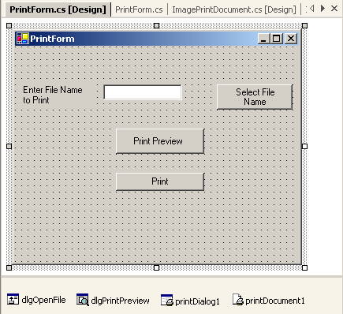
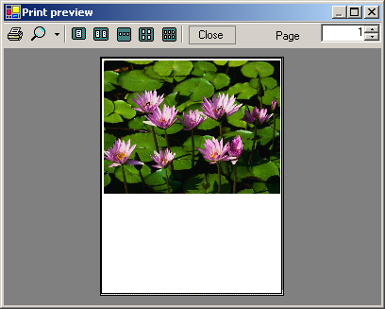
GDI+ Printing
Output

Slide 23
GDI+ Printing Contd…
Create the interface.
Add OpenFileDialog control and name it as dlgOpenFile. Link this control with the btnFile button to populate the TextBox (txtFileName) with the selected file name.
Add PrintPreviewDialog control and name it as dlgPrintPreview. Link this control with the btnPrintPrev button to display the dialog when the button is clicked.
Add PrintDialog control and name it as dlgPrint. Link this control with the btnPrint button to display the dialog when the button is clicked. Call the Print() method.
Add a PrintDocument control with the name printDocument1. Set the properties describing the printing details
Create an instance ImagePrintDocument of PrintDocument class. Override the OnPrintPage() method of this class. This method includes the actual functionality to generate the print preview. Create an image object in this method and pass it to the DrawImage() method of the graphics reference. The class has two constructors and one property which can be used to set the file name.

Slide 24
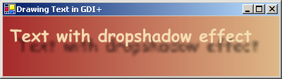
Creating Text Effects with GDI+
Override the OnPaintBackground() method of the Form control to create a draw area. Use a LinearGradientBrush to fill the background with two-color gradient.
Code the Paint event of the form to display text with shadow.
  Create a bitmap image to draw the text and its shadow.
  Create a graphics object of this bitmap and transform its position using a matrix. This is where the shadow will be displayed.
  Draw the shadow using the graphics object created in the previous step.
  Set the InterpolationMode and TextRenderingHeight of the default graphics object provided by the PaintEventArgs argument.
  Blow the image created with shadow to fill the form background area.
Display the main text on top of the shadow.

Slide 25
Summary
GDI+ provides the basic functionality to implement graphics in WinForms. GDI+ resides in System.Drawing.dll assembly.
The Graphics class is present in the System.Drawing namespace. It cannot be inherited.
The CreateGraphics() method is used to create the Graphics object. It is a method of the Control class.
Graphics objects can also be created from any object that derives from the Image class. This is done by using the FromImage() method of the Graphics class:
The Pen object can be used to specify fill styles for objects. The Pen class belongs to the System.Drawing namespace and cannot be inherited.
The Brush class is used to fill shapes with solid color. It is abstract and belongs to the System.Drawing namespace.
The Color structure is used to create or use colors for graphics in GDI+. It has various color names as its members which can be invoked to display particular colors.

Slide 26
Summary Contd…
The DrawLine() method of the Graphics class is used to draw a line on the screen.
The DrawString() method of Graphics class is used to display text on the screen without using any text related controls.
The DrawImage() method of Graphics class is used to draw image files on the screen
System.Drawing.Drawing2D namespace includes the gradient brushes, Matrix and GraphicsPath classes to provide the functionality of 2-dimensional and vector graphics.
The PrintDocument class is used for printing GDI+ objects. This class is defined in the System.Drawing.Printing namespace.
System.Drawing.Text namespace contains the TextRenderingHeight enumeration which is used to define the mode of the rendered text.

